Slide 1
Review of Differences in Ridership
Cyclistic Bike-Share
November 2021

Slide 2
Issue/solution
Problem:
What aim do our marketing strategies need to increase the conversion of casual riders to annual membership holders?
Solution:
Learn how annual members and casual riders use Cyclistic bikes differently

Slide 3
Analytical goals
Why:
Investigate customer values and use to ensure maximum conversion to Cyclistic membership.
How:
Share with marketing team to aide in next targeted campaign.

Slide 4
Explain how we do this
Reviewing user data from the last 12 months
Differences between day of the week, number of rides, length of rides, and station use.

Slide 5
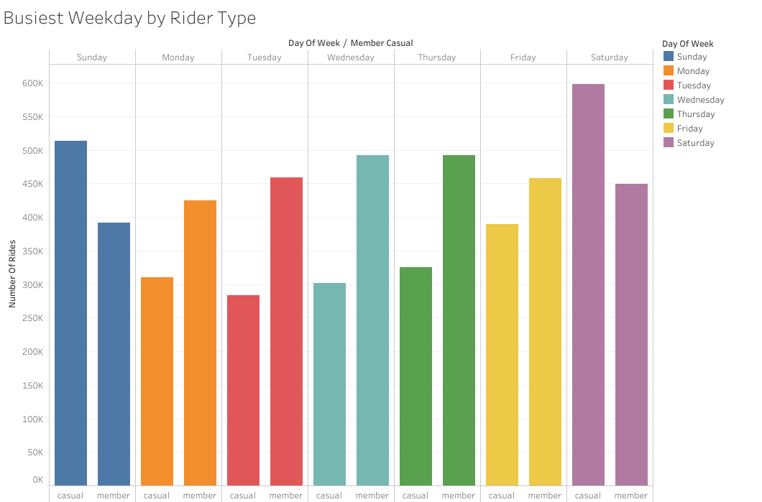
Findings #1

Slide 6
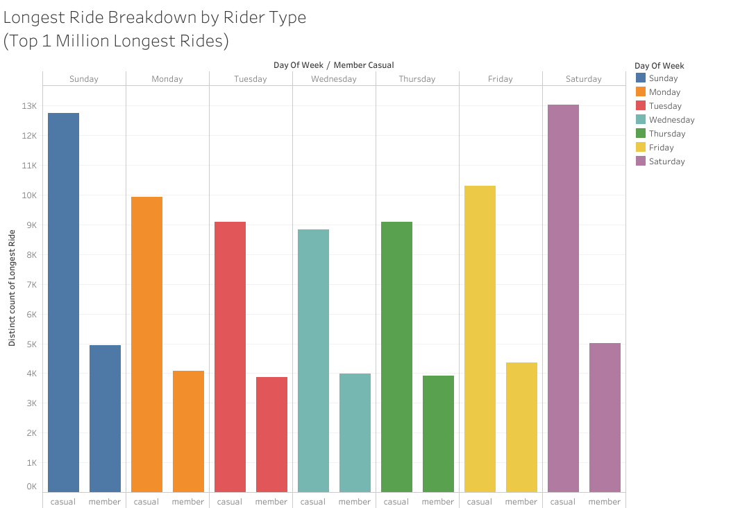
Findings #2

Slide 7
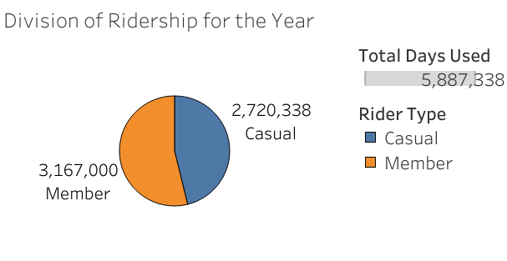
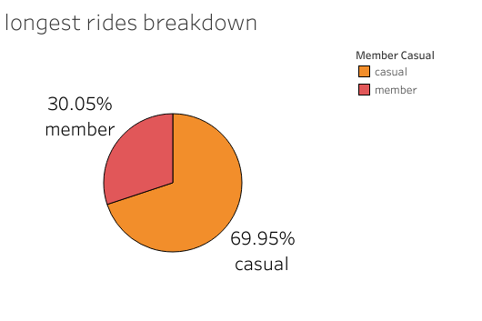
FINDINGS #3

Slide 8
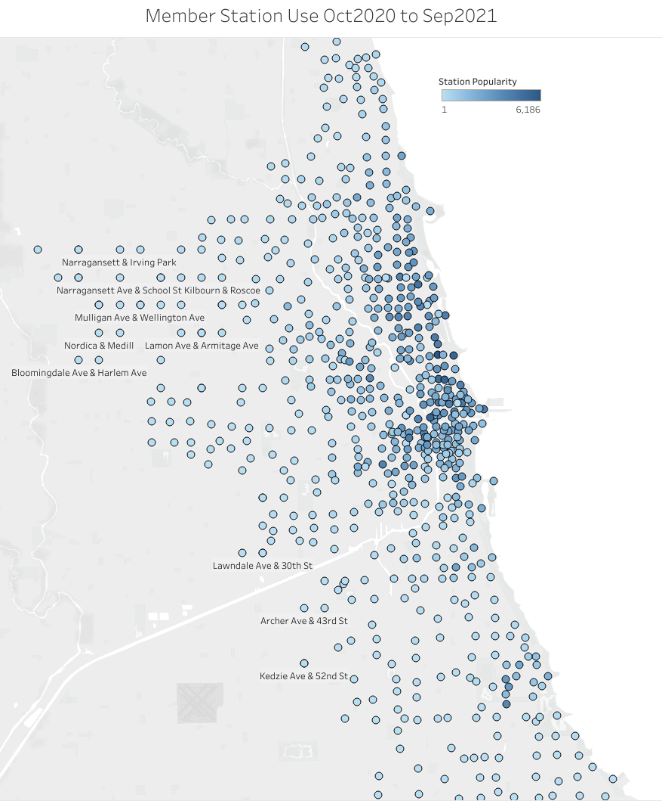
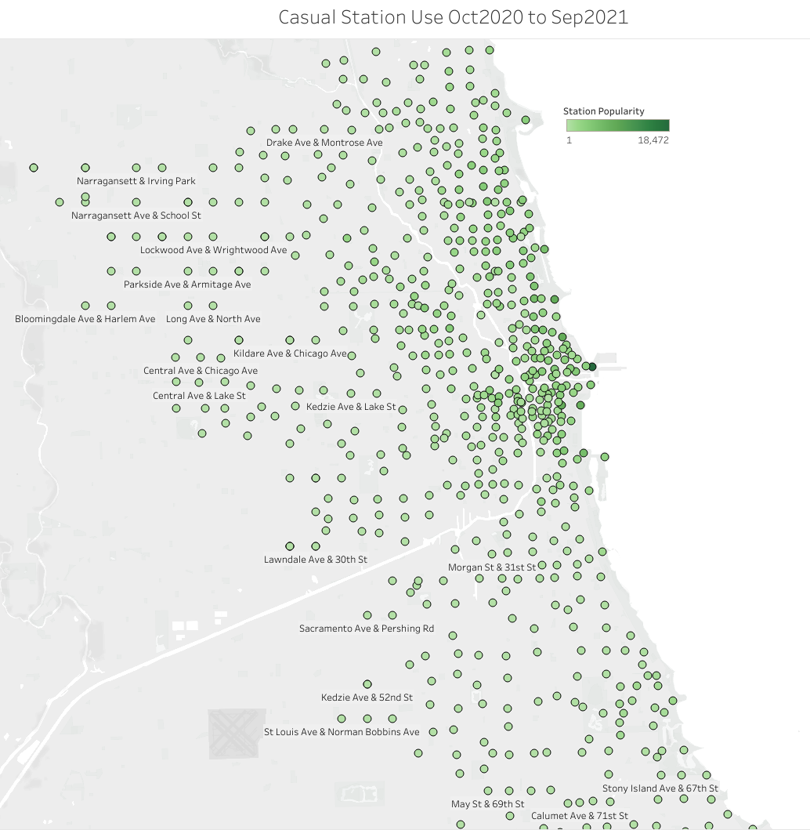
FINDINGS
Peak usage for September of 2021
https://public.tableau.com/views/12MonthReviewofRidershipcapstoneproject/Dashboard2?:language=en-US&:display_count=n&:origin=viz_share_link

Slide 9
SUMMARY
Giving insight to our Marketing team to help with next marketing campaign.
Casual riders ride during weekends for longer than membership holders.

Slide 10
FURTHER EXPLORATION
Work with teams to investigate to alter membership options
Work with teams to update collection of data and distance ridden by users.

